Slide 1

360 Marketing Plan
Lango Ltd. 2006-2013 All rights reserved
August- November 2013

Slide 2
Lango 360° Marketing Campaign
Lango new release Marketing Plan will be Lean and robust:
All concepts and strategies will be nimble and performed in increments to allow for just-in-time tuning:
Real-time and on-demand confirmations of what delivers the most users.
Leverage all channels: pay per click search, email campaign, sponsoring a newsletter, web banner ads, dynamic-daily content driven ads, leveraging partner audiences and new Public Relations Blitz.

Slide 3
Program Agenda
Planning Parameters
Objectives
Strategies
Target Audience
Timing
Budget
Discovery
Feature Release
Previous Media Results
Media Recommendations
Budget Allocation
Next Steps

Slide 4
P
Planning Parameters

Slide 5
Planning Parameters
Blog reviews mean exposure. Big blogs mean bigger exposure. It’s as simple as that. Lango wants to develop a big audience! The bigger the blog exposure, the more you benefit, especially if our product is solid and receives a good review.
Objectives:
App Awareness
Capture New Users
Increase DAU’s
“Shout Out” Product Differentiators

Slide 6
Competitive landscape - features
 | Feature | Lango | Message.me | WhatsApp | Just.me | Line | Skype | Google Hangout | Facebook Messenger
Delivery | Group messaging (Chat) | ✔ | ✔ | ✔ |  |  | ✔ | ✔ | ✔
 | Peer-to-Peer | ✔ | ✔ | ✔ |  | ✔ | ✔ | ✔ | ✔
 | Seamless post to social media | ✔ | ✔ |  | ✔
 | International (out of USA) |  | ✔ | ✔ | ✔ | ✔ | ✔ | ✔ | ✔
Content | In-app push notifications | ✔
 | Dynamic content uploads | ✔
 | In-app Ads infusion | ✔
 | In-house content develop. | ✔ | ✔
 | Text on pictures | ✔ | ✔
 | Insert personal pictures | ✔ | ✔ | ✔ | ✔ | ✔ | ✔ | ✔ | ✔
 | Send location |  | ✔ | ✔ |  | ✔ |  | ✔
Message Creation | In-app VG Store | ✔ |  |  |  | ✔
 | Insert Icon | ✔ | ✔ | ✔ |  | ✔ |  | ✔ | ✔
 | Insert Stickers (large icons) | ✔
 | Auto-suggestions of icons | ✔
 | Canvas the background | ✔
 | “My Stuff” Page | ✔ |  |  | ✔
✔ Already active
✔ Under dev. (Active before Sept. 2013)

Slide 7
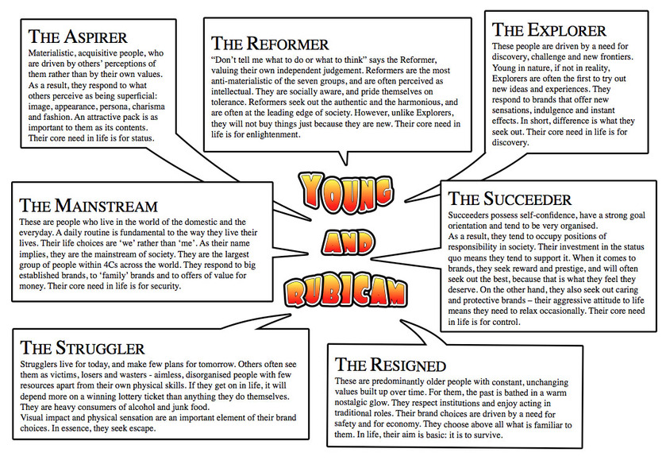
Planning Parameters
Target Audience – Segment
Psychographic-Not Important
Demographic
Phase 1: Female 35-50
Phase 2: Male 18-30

Slide 8
Planning Parameters
Launch Phase 1: Female 35-50
PR, Social Media, Blogs, Ad Awareness campaign focused on Moms Life After Kids go Back To School
Launch Phase 2: Male 18-30
All Channels focused on Julio Jones promotion, college football, NFL etc

Slide 9
Planning Parameters
Rolling Program
Continued efforts to generate awareness across two identified demographics
Female 35-50/ Male 18-30
Channels:
All the continued efforts on “in-house” channels
Introduce new email marketing campaign
Video marketing and video ads
New Loyalty Program
Branded in-app channels in the store and/or Group Chat

Slide 10
Planning Parameters: Timing
August 27 Initial Public Public Announcement of Lango 5.0
Public Announcement of Lango 5.0
Theme: 100 ways to send a text…one app…Lango
Channels:
6 Social Media Channels: Facebook, Twitter, Pintrest, YouTube, Google+, Vine
Lango.me: Homepage, Blog
Customer Support
New Email Campaign

Slide 11
D
Discovery

Slide 12
Upcoming Launch Features
Version 4.15 (8/18/13):
iPhone
Group Chat (Phase I)
No option to leave group, only mute it
No option to rename group
No group image
New GUI in all screens
Coinless compose
Android
- Group Chat (Phase I)
No option to leave group, only mute it
No option to rename group
No group image
Sending Image from camera or gallery (MMS to any Lango user)
Coinless compose

Slide 13
Upcoming Features
Version 4.16
iPhone (Planned for Aug. 26)
Gallery - the new Store, My Packs, and Insert Icon
Android (Planned for Aug. 29)
New GUI in Inbox, Compose/Thread
Gallery (also in the new GUI) - the new Store, My Packs, and Insert Icon
Version 4.17
iPhone (Planned for ~Sep. 7)
- Group Chat:
Delete & leave group
Rename group
Group image
Android (Planned for ~Sep. 10)
- Group Chat:
Delete & leave group
Rename group
Group image
Full app new GUI
More animations

Slide 14












Crowded Marketplace

Slide 15
PR Planning Parameters
Easily digestible value proposition
Address the skeptics before they ask questions
Build “stand-alone” value for each component of the solution; augment the value of the whole in greater excess than the sum of its parts!

Slide 16











Mommy – Going Back to School

Slide 17









College Sports / Football

Slide 18

How do we get there?

Slide 19

MEET YOUR CUSTOMER

Slide 20

Clarity in Messaging
VALUE PROPSITION
OPSITION

Slide 21

SMS
MMS
IMS
RCS
Lango!

Slide 22

Packaging
To The Media
With love,
Lango

Slide 23
PR Deliverables for Launch
A complete press kit
Press Release
Screen shots (customized per media outlet)
Media Q&A (interview in proxy) – ours is fun!
Reviewer’s Guide
Demonstration video
Refined with each new target demo / audience

Slide 24

Today’s Reality
Tomorrow’s Perception

Slide 25
Thought Leadership
Multiple media trained spokespeople
Pocket quotes from executives
Blog posts with executive by lines
Contributed articles on messaging trends
Feature wire stories (articles we write)
Awards

Slide 26
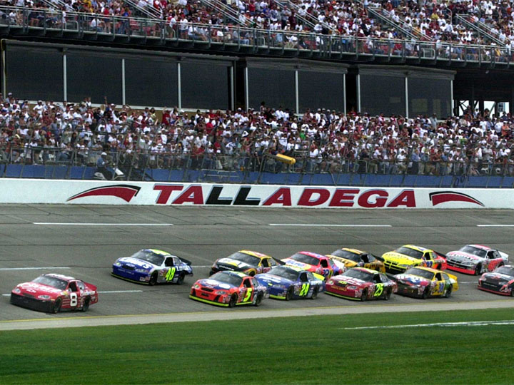
Now We’re Off to the Races

Slide 27
Remainder H2-2013 Expected News
5.0 Launch
Content for women (with children back in school!)
Content for college sports / football fans
Product improvements continue
Content for the next target audience
And the one after that
And the one after that
And the one after that

Slide 28

Lather. Rinse. Repeat!

Slide 29
Audience Specific PR
We don’t see an uptick in relevant usage
We see an uptick in relevant usage
Discontinue outreach
Move on to next target
Continue outreach
Move on to next target
Assess what went wrong
Monitor usage
Promote new content
Monitor usage

Slide 30
Ongoing
New target audience evaluation
Spark and flair content creation
Audience specific social media campaigns – all channels
Announce new packs over appropriate wire
Announce content additions over MobilityWire; prMac
Audience specific media outreach
Monitor for relevant media opportunities
Reporting results

Slide 31
Stages of Review
^{First Look}
The simplest write-up is what we call a first look. A first-look review is generally written when we get an app or accessory that is “hot” and we want to give readers some information about it as soon as possible. This type of review covers the bare essentials that a reader needs to know: what the product does, how much it costs, any special features (like accessories or in-app purchase, different levels for a game, etc.), what it compares to, and what the developer is well-known for (if he’s written a number of apps or shipped other hardware). First-look reviews often get a follow-up in-depth review, especially if we want to keep up with the news cycle before we have a chance to sit down and look at the product in more detail.
^{Overview}
The next level of depth is an overview. This may be a product that isn’t getting a lot of press, but is something that we’re interested in. Overview reviews give a reader an idea of what the product does, what the cost is, and how it compares feature-wise with other apps or hardware, but then goes into more depth of what the product actually does and how it works.
^{Hands On}
The hands-on review is usually written after a blogger has had a chance to work with a product for a while. In this type of review, a blogger often talks about using the product to address a particular use case. It may not necessarily go into a lot of detail about competing products, but it’s a good way for readers to get an idea of exactly what an app or hardware can or cannot do. We often contact the developer during a hands-on review so we can better understand the product as we test it.
^{In Depth}
The in-depth review is where the reviewer describes every last little detail of the product, discusses the developer’s experience and compares it with similar products, takes a huge number of photos or screenshots to demonstrate unique or different features of the product or user interface, and even offers suggestions on how the product can be improved. In-depth reviews take
the most time, which is why they’re also the least likely type of review you’ll receive.

Slide 32
M
Media Recommendations

Slide 33
User Acquisition Summary To Date

Slide 34
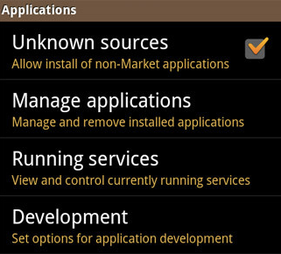
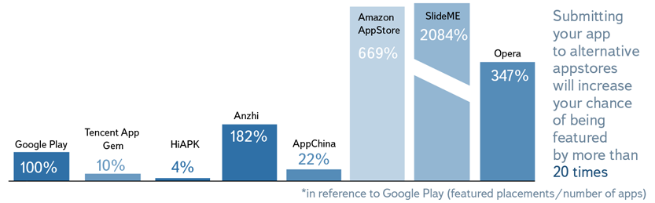





1+1=3 Increase Lango Distribution
Lango User Acquisition channel

Slide 35
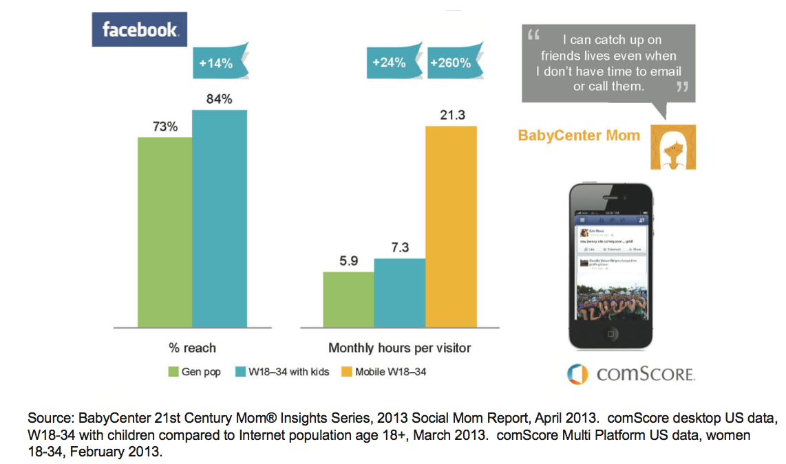
Why Moms?

Slide 36
EMAIL Channel Strategy
Phase 1
Phase 2
Phase 3
Traditional
Methodologies
ACQUISITION ENGAGEMENT GROWTH/RETENTION
Advanced Tactics
Sweeps / Co-regis.
eNewsletter
Testing
Lifecycle
Marketing
Trigger Based
Personalization
LANGO CAMPAIGNS
LANGO PROGRAMS
PROSPECT ACTIVE USER LANGO ADVOCATE
Acquire – Through sweepstakes, online promotions, co-registration (Profile Needed), email marketing
Engage Audience / Initiate Dialogue - By delivering recurring, sequenced and relevant communications PR
Grow / Retain – Take aggressive approach with customer & prospect base, create scenarios, delivering relevant content with eye on opt-out click rates
Build email programs around customer lifecycle and date of opt-in, refresh offers every 30 days

Slide 37
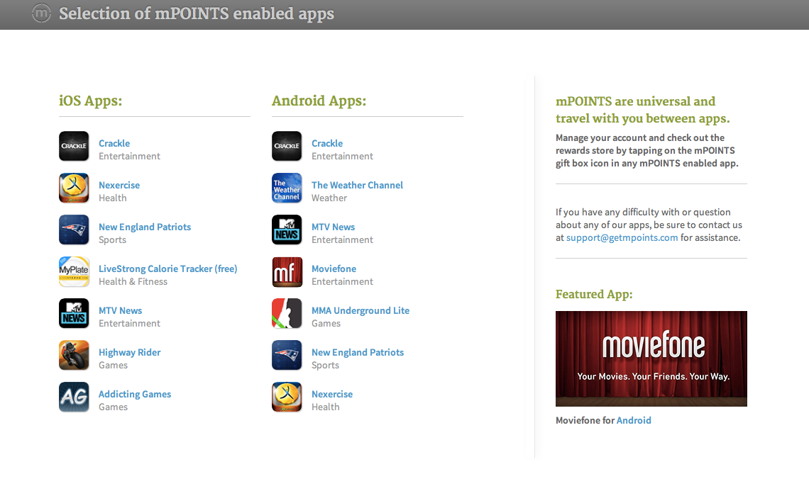
Incorporate new loyalty program platform
Incorporate mPoints loyalty platform to add “stickiness”

Slide 38
Content Awareness
Built to follow the editorial calendar to promote new content and comprehensive campaigns beginning Aug. 27
TWO target demographics:
13-25 male/female 50/50 split
35-50 female only
We will test on responsiveness, retention and viral invites sent from each demographic within the app
Web banner ads, HTML 5
Live, dynamic ad featuring “Icon of the Day”
Pre-roll and post role video/ game ads
NOTE: Strategy of buying all ads across 1-3 properties OR buying one type of ad across many properties will be determined on data gathered from advertising competitive radar.
Notes:
Broad stoke plus targeting. Male demo 18-

Slide 39
Target Media Channels
Mobile advertising (non-FB) (Asi): direct click-to-download
Online sites (gossip, celebrity, mom blogs etc): Identify key demographics and make cross-channel ad-buys
Sponsored Tweets
Email Marketing
Retargeting via ad network
Facebook Promoted App and New content ads
Group Messaging Fanfare (PR and Paid ads)
Facebook Flair contest= big prize $5,000 trip to Hawaii
Marketing Stunts
Notes:
Broad stoke plus targeting. Male demo 18-

Slide 40
Test Media Channels
Objective: Test variety of partners (mobile and online) to identify best performing sites and most responsive audience
Strategy: Focus on two main targets and test several partners with high composition of each.
Leverage a transparent network to identify best performing partner sites and responsive targets.
Parameters:
Targets – W25-54
Timing – September 2013
Budget - $150K
Notes:
Broad stoke plus targeting. Male demo 18-

Slide 41











Tier | 1 - Network | 2 - Content Sites | 3 – Mobile Network
Target | Open Network buys to determine best audience | W25-54 | W25-54
Budget | $75K | $75K | Placeholder (ASI)
Sites Like
Notes:
Broad stoke plus targeting. Male demo 18-

Slide 42
Budget Assumptions $250k
Buy breakdown:
Network spend across demographics to see what performs best: $75k
Content buys targeted at women 35-50: $75k
Crackle spend targeting consuls and web content: $25k
Email Marketing: $5k
Mobile ads (Asi): $50k
$20k hold to observe performance

Slide 43
KPI’s for Ad Spend
All Awareness based Ad Spend is new for Lango. Therefore we must try small budget spends and track effectivenss.
It is not possible to put arbitrary number KPI’s with awareness spend as we are not looking to be judged on direct CPI rates like our current mobile spend.
Therefore… we prospose the following:
Put $20k into each campaign as planned.
Evaluate the impact on downloads for each campaign
Decide as a team if there is enough impact to continue with the full $75k spend or begin targeting a different demographic/ different channels.

Slide 44
August 27-Sept 25, 2013 | MONDAY | TUESDAY | WEDNESDAY | THURSDAY | FRIDAY | SATURDAY | SUNDAY
WEEK 1 |  | 27 | 28 | 29 | 30 | 31 | 1
WEEK 2 | 2 | 3 | 4 | 5 | 6 | 7 | 8
WEEK 3 | 9 | 10 | 11 | 12 | 13 | 14 | 15
WEEK 4 | 16 | 17 | 18 | 19 | 20 | 21 | 22
WEEK 5 | 23 | 24 | 25 | 26 | 27 | 28 | 29
Kardashian Twitter Campaign
PR release August 27- Launch of new Features
360 Launch Campaign Begins
Phase 1 ad Campaign: Females 35-50 (Mom’s Go Back To School)
Phase 1 ad campaign continues through Sept
On-going PR efforts pitching new Lango Features

Slide 45
Sept 26- Oct 2013 | MONDAY | TUESDAY | WEDNESDAY | THURSDAY | FRIDAY | SATURDAY | SUNDAY
WEEK 1 |  |  |  | 26 | 27 | 28 | 29
WEEK 2 | 30 | 1 | 2 | 3 | 4 | 5 | 6
WEEK 3 | 7 | 8 | 9 | 10 | 11 | 12 | 12
WEEK 4 | 14 | 15 | 16 | 17 | 18 | 19 | 20
WEEK 5 | 21 | 22 | 23 | 24 | 25 | 26 | 27
Evaluation Date for Launch Campaign spend 1
NFL Canada Campaign Kick Off
PR release early Oct about additional feature upgrades, and NFL Canada
PR focus on College and NFL Footbal
Phase 2 Ad Campaign: footbal fans
Julio Jone Campaign kicks off for 30 days

Slide 46
N
Next Steps

Slide 47
Next Steps
 | Approve Budget
 | Approve Pan
 | Execute 360 Plan
 | Count new users

Slide 48


Thank you!

Slide 49
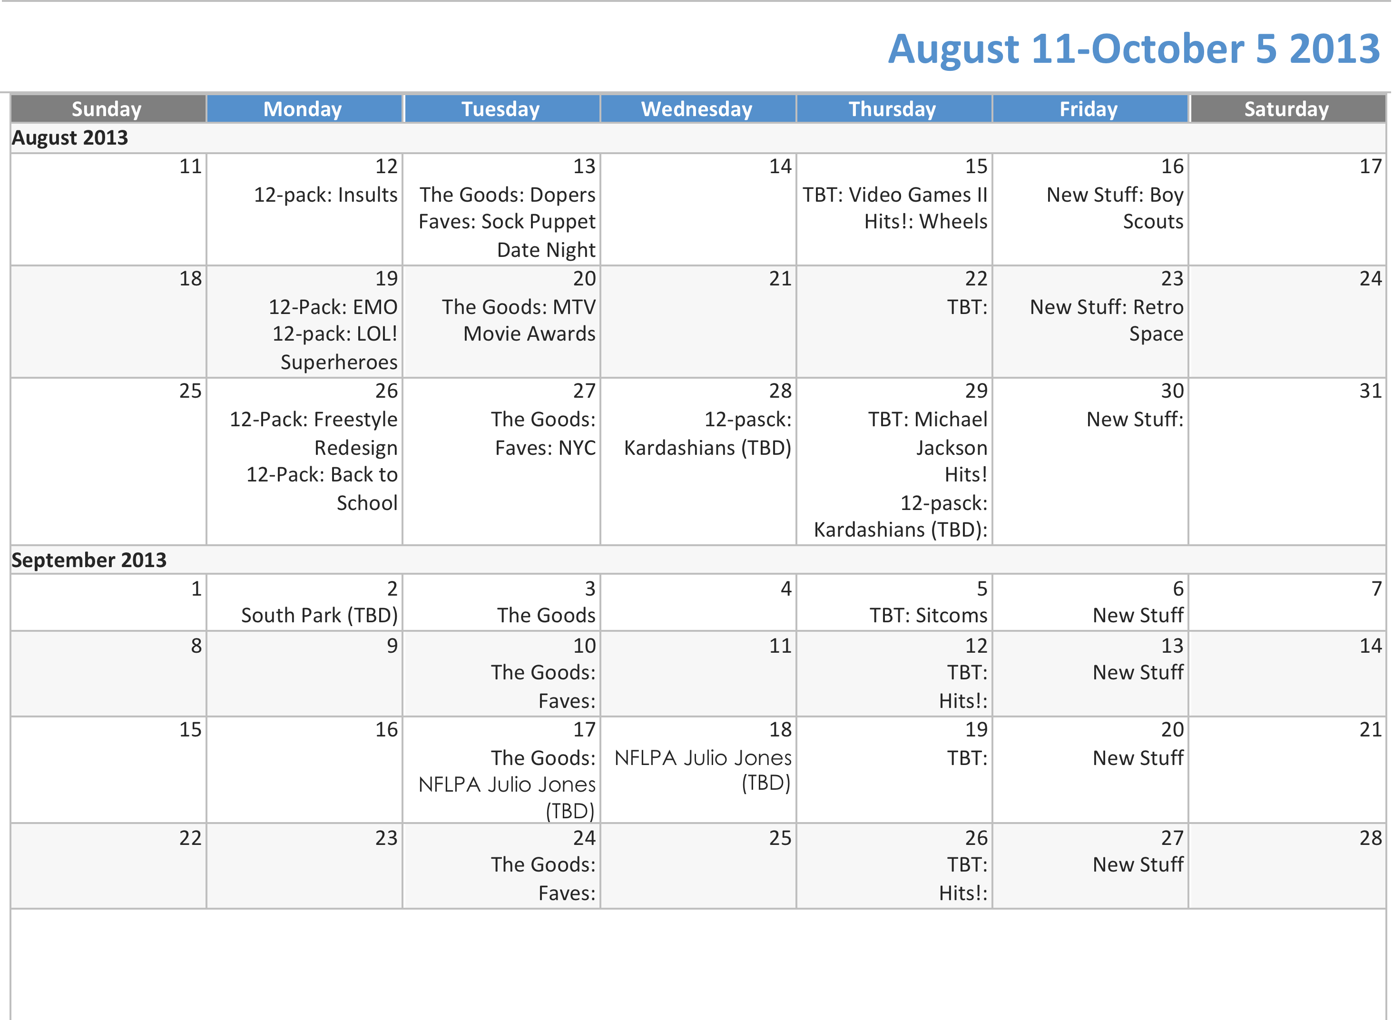

Slide 50
